Slide 1

Data Science Final Project
By Tsedey Aragie
filmstockinc@gmail.com

Slide 2
The problem or challenge
What makes a cohesive nation?
How is social cohesion measured? In my dataset there are 12 indicators that are measured for 178 countries. The nations are ranked with #1 being the least cohesive least stable country, and 178 as the most stable most cohesive country.

Slide 3
Fragile State Index by Fund For Peace
C1: Security Apparatus
C2: Factionalized Elites
C3: Group Grievance
E1: Economic Decline &Poverty
E2: Uneven Economic Development
E3: Human Flight & Brain Drain
P1: State Legitimacy
P2: Public Services
P3: Human Rights & Rule of Law
S1: Demographic Pressures
S2: Refugees & IDPs Internally Displaced Persons
X1: External Intervention
12 Indicators

Slide 4
C1 Security Apparatus
security threats to a state, such as bombings, attacks and battle-related deaths, rebel movements, mutinies, coups, or terrorism.
takes into account serious criminal factors, such as organized crime and homicides, and perceived trust of citizens in domestic security.
C2 Factionalized Elites
fragmentation of state institutions along ethnic, class, clan, racial or religious lines, as well as and brinksmanship and gridlock between ruling elites.
It also factors the use of nationalistic political rhetoric by ruling elites, often in terms of nationalism, xenophobia, communal irredentism (e.g., a “greater Serbia”) or of communal solidarity (e.g., “ethnic cleansing” or “defending the faith”). In extreme cases, it can be representative of the absence of legitimate leadership widely accepted as representing the entire citizenry
C3 Group Grievance
focuses on divisions and schisms between different groups in society – particularly divisions based on social or political characteristics – and their role in access to services or resources, and inclusion in the political process
may also have a historical component, where aggrieved communal groups cite injustices of the past, sometimes going back centuries, that influence and shape that group’s role in society and relationships with other groups. This history may in turn be shaped by patterns of real or perceived atrocities or “crimes” committed with apparent impunity against communal groups

Slide 5
E1 Economic Decline & Poverty
considers factors related to economic decline within a country. For example, the Indicator looks at patterns of progressive economic decline of the society as a whole as measured by per capita income, Gross National Product, unemployment rates, inflation, productivity, debt, poverty levels, or business failures
sudden drops in commodity prices, trade revenue, or foreign investment, and any collapse or devaluation of the national currency.
E2 Uneven Economic Development
inequality within the economy, irrespective of the actual performance of an economy.
looks at structural inequality that is based on group (such as racial, ethnic, religious, or other identity group) or based on education, economic status, or region (such as urban-rural divide)
E3 Human Flight & Brain Drain
considers the economic impact of human displacement (for economic or political reasons) and the consequences this may have on a country’s development.
voluntary emigration of the middle class – particularly economically productive segments of the population, such as entrepreneurs, or skilled workers such as physicians – due to economic deterioration in their home country and the hope of better opportunities farther afield

Slide 6
P1 State Legitimacy
the representativeness and openness of government and its relationship with its citizenry.
looks at the population’s level of confidence in state institutions and processes, and assesses the effects where that confidence is absent, manifested through mass public demonstrations, sustained civil disobedience, or the rise of armed insurgencies.
P2 Public Services
presence of basic state functions that serve the people. On the one hand, this may include the provision of essential services, such as health, education, water and sanitation, transport infrastructure, electricity and power, and internet and connectivity
it may include the state’s ability to protect its citizens, such as from terrorism and violence, through perceived effective policing
P3 Human Rights & Rule of Law
considers the relationship between the state and its population insofar as fundamental human rights are protected and freedoms are observed and respected.
The Indicator looks at whether there is widespread abuse of legal, political and social rights, including those of individuals, groups and institutions (e.g. harassment of the press, politicization of the judiciary, internal use of military for political ends, repression of political opponents). The Indicator also considers outbreaks of politically inspired (as opposed to criminal) violence perpetrated against civilians.

Slide 7
S1 Demographic Pressures
considers pressures upon the state deriving from the population itself or the environment around it.
Indicator measures population pressures related to food supply, access to safe water, and other life-sustaining resources, or health, such as prevalence of disease and epidemics.
S2 Refugees & IDPs
measures the pressure upon states caused by the forced displacement of large communities as a result of social, political, environmental or other causes, measuring displacement within countries, as well as refugee flows into others.
measures refugees by country of Asylum, recognizing that population inflows can put additional pressure on public services, and can sometimes create broader humanitarian and security challenges for the receiving state, if that state does not have the absorption capacity and adequate resources
X1 External Intervention
considers the influence and impact of external actors in the functioning – particularly security and economic – of a state.
focuses on security aspects of engagement from external actors, both covert and overt, in the internal affairs of a state at risk by governments, armies, intelligence services, identity groups, or other entities that may affect the balance of power (or resolution of a conflict) within a state.
demographic characteristics, such as pressures from high population growth rates or skewed population distributions, such as a “youth or age bulge,” or sharply divergent rates of population growth among competing communal groups, recognizing that such effects can have profound social, economic, and political effects.
economic engagement by outside actors, including multilateral organizations, through large-scale loans, development projects, or foreign aid, such as ongoing budget support, control of finances, or management of the state’s economic policy, creating economic dependency

Slide 8
Why I chose this topic?
Timeliness
This has been a topic of interest to me, for a while. I experience and see the world differently from a young age I have had to balance two very different worldviews, and the two countries that have shaped my identity happen to be experiencing a heightened level of social and political polarization at this time.

Slide 9
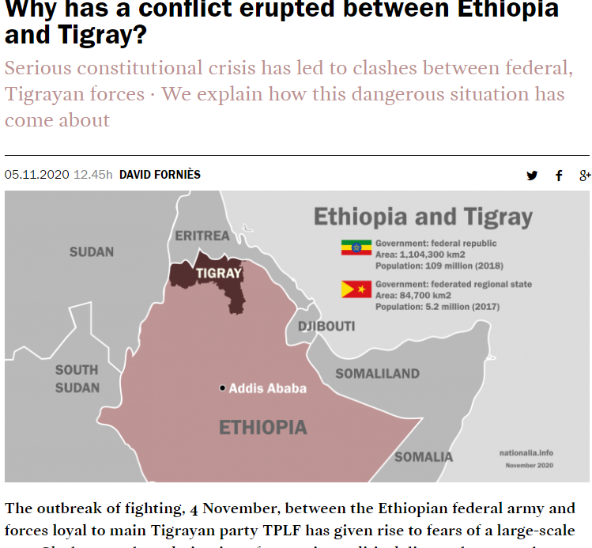
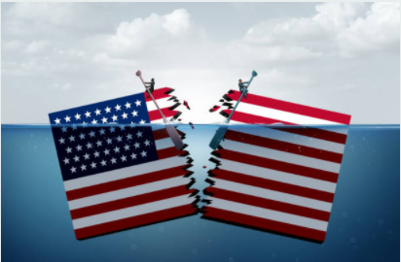
Social/Political Polarization - brewing for years
A COUNTRY DIVIDED

Slide 10
Research
The owner of the data, Fund For Peace, an NGO has collected data on several countries and their data set spans from year 2006-2020 – they have covered a total of 15 years and will begin working on 2021 data to be published in the Spring. I wanted to better understand how they went about collecting their data. I needed more understanding about their primary data sources and their process. I was able to reach Nate Haken the Program Director at Fund For Peace. He shared invaluable information that I wouldn’t have been able to obtain from just looking at the website. They have a unique set of data and I was excited to find this information that spans over a decade. Especially the content and factors that they analyzed were closey related to my topic of interest.
In order to understand social cohesion you have to consider the opposite end of the spectrum, which is instability and polarization. Kind of like understanding how light effects darkness. As an analogy exploring darkness on a scale and increasing the presence or absence of light. Just like that this data measures on a scale types of incidents that were reported.
To beter understand their process they took three different data streams and triangulated the 12 indicators and sub indicators using primary data from World Bank and UNHCR – United Nations High Commissions for Refugees. The the approach taken is to scale and normalize weighted averages. They scanned millions of online public documents and used boolean seraches that they created. They took dynamic factors and content analysis with search strings and would flag counrtires with sharp change from one year to the next. The focus was to identiy events that drove the factors explained in the Fragile State Index.
Additionally two teams of analysts conduct a qualitative analysis to asess for biases and major events and trends in each of the countries. The two teams have a firewall between them and they trianguate the pre-existing date to determine if the generate the same outcome. This is done by a small team.
The methodology was pretty consistent for each year, beginning with 147 countries and now a total of 178 countries on their list.

Slide 11
The hypothesis (or prediction)
Stable nations have minimum grievances; therefore unstable nations have a greater instance of human rights violations?
Definition: Social cohesion is the absence of polarization and divison. Also defined as ‘stable’ or ‘very stable’ nations.

Slide 12
My testing method
What methods and databases were used for my analysis?
Machine Learning, Supervised, classification
K-Learns, nn-model, deep-model, and linear regression.
Databases: Pandas, Numpy, Tensorflow, Sklearn (preprocessing, model_slection, metrics, linear model, and matplotlib.
Supervised ML
Regression

Slide 13
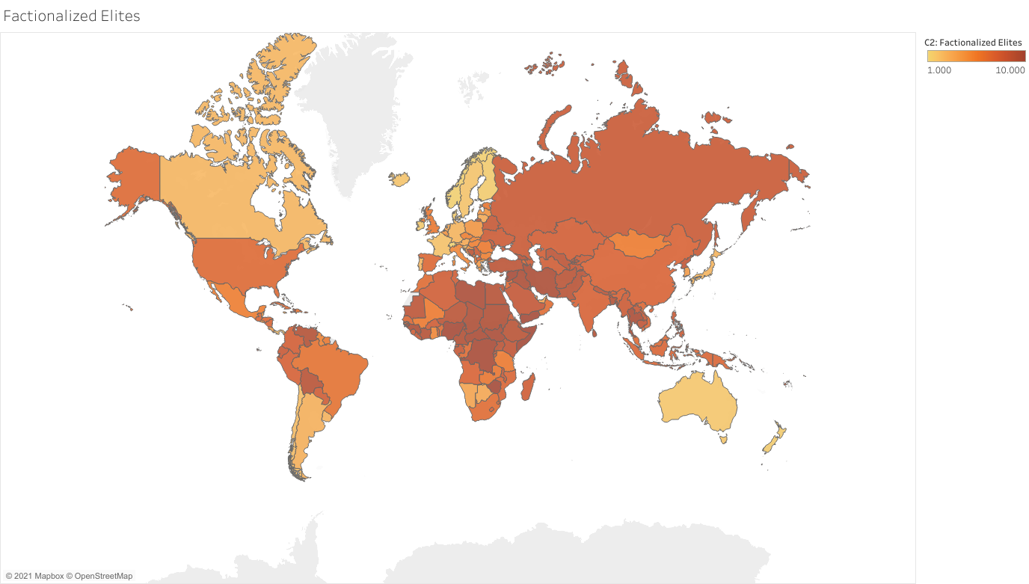
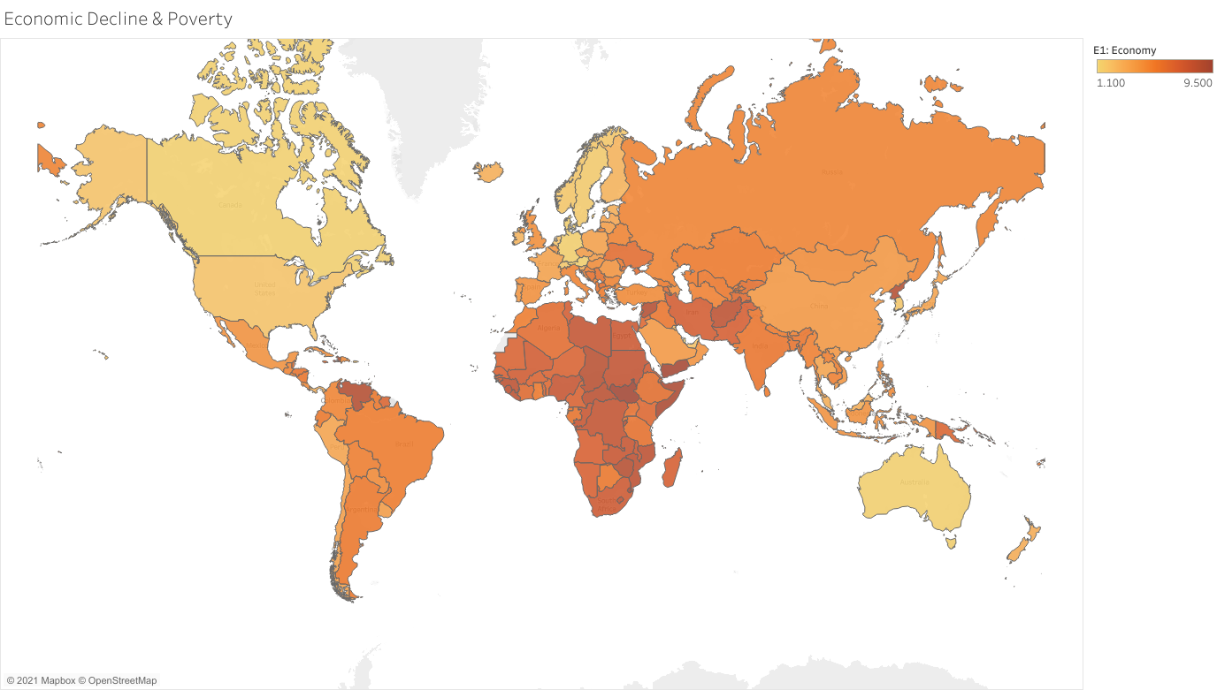
A comparative view
The assumption is that wealthy nations are socially cohesive. The nations with very low values of decline are also experiencing heightened levels of fragmentation.
15
Dashboard from Tableau

Slide 14
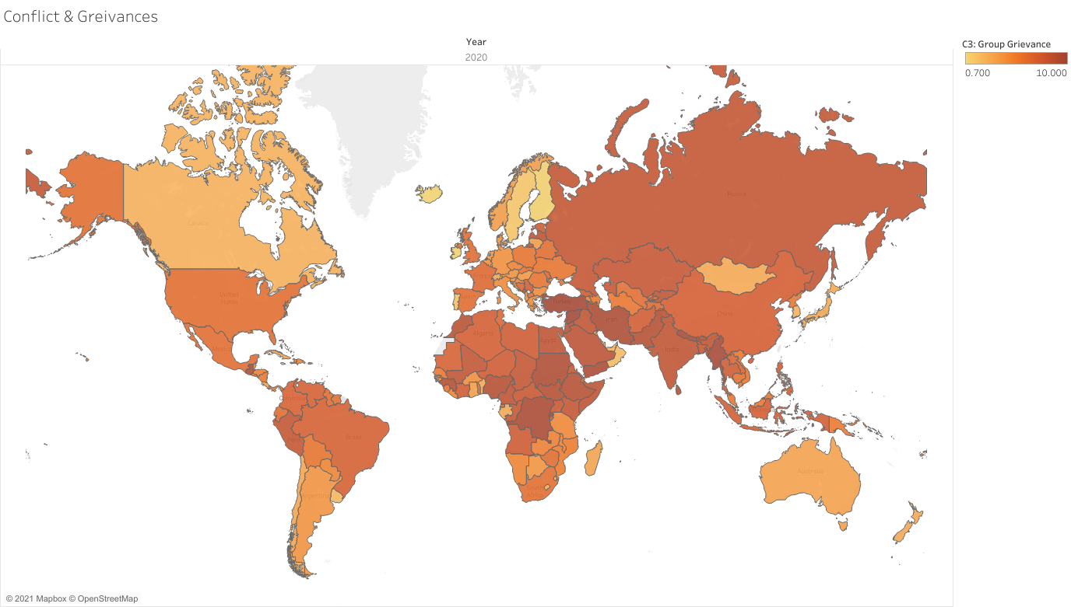
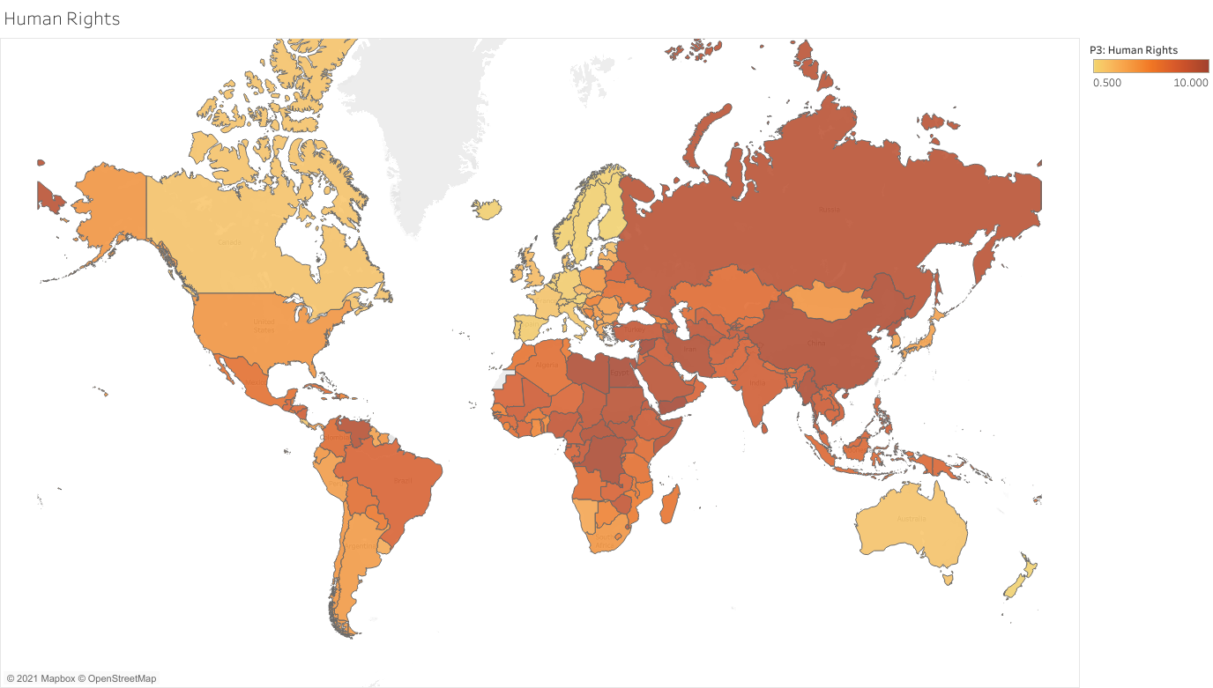
A comparative view
The assumption: grievances are correlated to a populations sense of perceived freedom and human rights being
15
Dashboard from Tableau

Slide 15
Tableau
https://public.tableau.com/profile/tsedey.aragie#!/vizhome/DataViz_fragilestateindex/C-indicators?publish=yes
Dashboard

Slide 16
Conclusion
Understanding the data source is critical to how confident I can be about the conclusion and story that I wish to draw upon.
Although I find the metrics that they have selected to be superior. It’s a bit puzzling to analyze all of these nations based on one or three languages. There are 178 countries, and to have a better understanding of social cohesion more data needs to be collected in these different languages. For budget reasons maybe select 5 countries to start collecting data.

Slide 17
Always consider language (not computer language) and cultural context when analyzing data.

Slide 18

What will I do next?
I would like to do a comparative review of the data over the past 10 years and then select certain countries that have experienced polarization and decline of social cohesion resulting in some level of genoicde and analyze what kind of news reports were published both internationall news agencies and within the country.

